Slide 1

A.I. tips and guides for devs
Using Copilot as a development tool

Slide 2
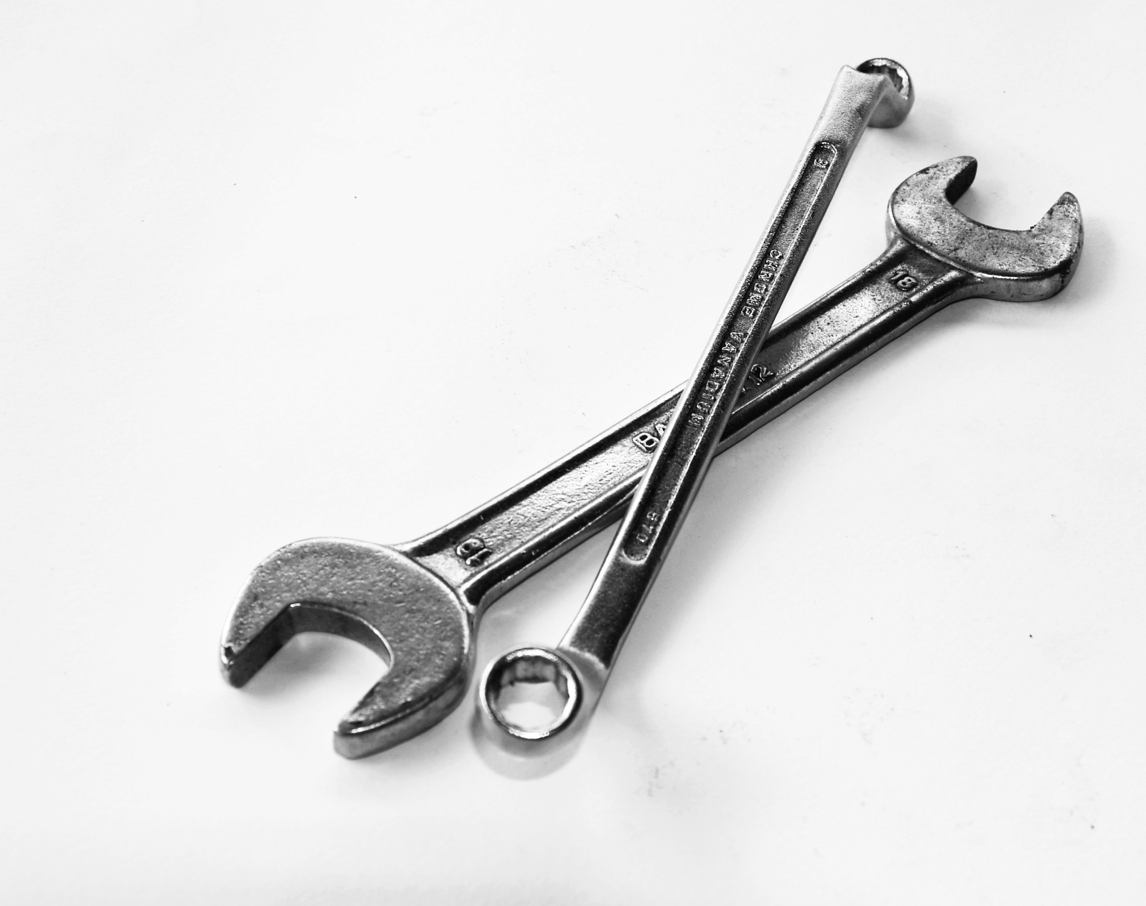
Copilot: Tool to improve your productivity

Slide 3

Non-deterministic

Slide 4

Faulty
Incomplete
Incorrect
Incoherent
Esta foto de Autor desconocido está bajo licencia CC BY-SA-NC

Slide 5

Road to perfection
High-level goal
Simple and specific steps
Give an example… or two

Slide 6

Prompt engineering… or art?

Slide 7

Tips
Experiment, refine, and educate
Open tabs to give context
Use best coding practices and standards
Make Copilot impersonate a role

Slide 8
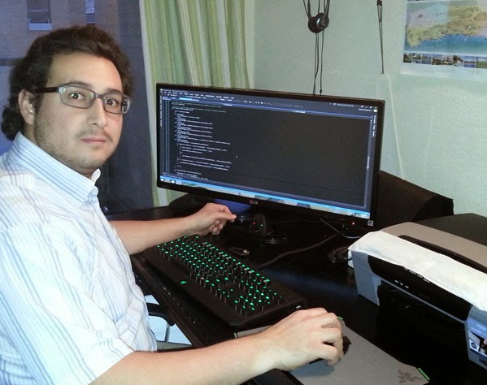
It’s your responsibility to review the code.
Esta foto de Autor desconocido está bajo licencia CC BY-NC-ND

Slide 9

Extra bonus
Reduce the fear of mistakes
Makes learning easier
Improves communication skills
Helps with documentation

Slide 10

Thanks
By Alberto Basalo and Copilot

